Slide 1
Input / Output Organization: Bus Structure - Bus Operation – Arbitration - Interface Circuits - Interconnection Standards

Slide 2
Bus Structure
The bus consists of three sets of lines used to carry address, data, and control signals. I/O device interfaces are connected to these lines for an input device.
Each I/O device is assigned a unique set of addresses for the registers in its interface.
When the processor places a particular address on the address lines, it is examined by the address decoders of all devices on the bus.
The device that recognizes this address responds to the commands issued on the control lines.
The processor uses the control lines to request either a Read or a Write operation, and the requested data are transferred over the data lines.

Slide 3
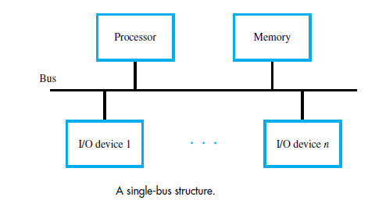

Slide 4
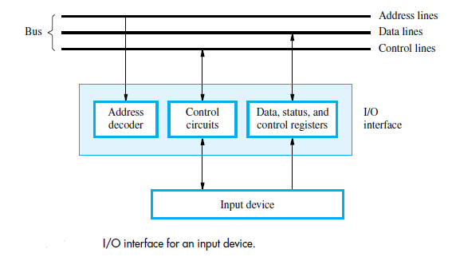

Slide 5
For example,
if the input device is a keyboard and if DATAIN is its data register, the instruction
Load R2, DATAIN
reads the data from DATAIN and stores them into processor register R2. Similarly, the instruction
Store R2, DATAOUT
sends the contents of register R2 to location DATAOUT, which may be the data register of a display device interface.
The status and control registers contain information relevant to the operation of the I/O device.
The address decoder, the data and status registers, and the control circuitry required to coordinate I/O transfers constitute the device’s interface circuit.

Slide 6
Bus Operation
The bus protocol determines when a device may place information on the bus, when it may load the data on the bus into one of its registers, and so on.
These rules are implemented by control signals that indicate what and when actions are to be taken.
Master or initiator- Device which initiate data transfers
Slave or target- Device addressed by master

Slide 7
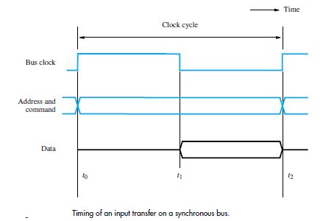
Synchronous Bus
All devices derive timing information from a control line called the bus clock
The timing diagram shows an idealized representation of the actions that take place on the bus lines.

Slide 8
Synchronous Bus
The sequence of signal events during an input (Read) operation. At time t0, the master places the device address on the address lines and sends a command on the control lines indicating a Read operation.
Information travels over the bus. The clock pulse width, t1 − t0, must be longer than the maximum propagation delay over the bus.
Also, it must be long enough to allow all devices to decode the address and control signals, so that the addressed device (the slave) can respond at time t1 by placing the requested input data on the data lines. At the end of the clock cycle, at time t2, the master loads the data on the data lines into one of its registers.
To be loaded correctly into a register, data must be available for a period greater than the setup time of the register. Hence, the period t2 − t1 must be greater than the maximum propagation time on the bus plus the setup time of the master’s register.

Slide 9
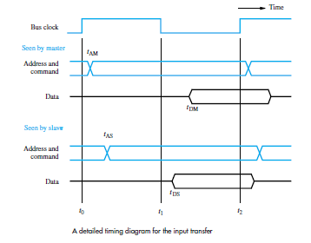

Slide 10
Multiple-Cycle Data Transfer
However, it has some limitations.
Because a transfer has to be completed within one clock cycle, the clock period, t2 − t0, must be chosen to accommodate the longest delays on the bus and the slowest device interface.
This forces all devices to operate at the speed of the slowest device. To overcome these limitations, most buses incorporate control signals that represent a response from the device.
These signals inform the master that the slave has recognized its address and that it is ready to participate in a data transfer operation.
They also make it possible to adjust the duration of the data transfer period to match the response speeds of different devices.
This is often accomplished by allowing a complete data transfer operation to span several clock cycles.

Slide 11
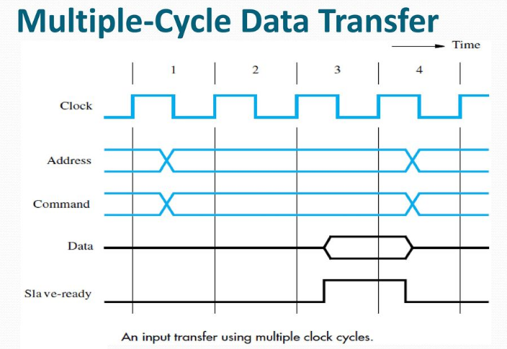

Slide 12
Asynchronous Bus
An alternative scheme for controlling data transfers on a bus is based on the use of a handshake protocol between the master and the slave. A handshake is an exchange of command and response signals between the master and the slave.
The master places the address and command information on the bus. Then it indicates to all devices that it has done so by activating the Master-ready line.
This causes all devices to decode the address. The selected slave performs the required operation and informs the processor that it has done so by activating the Slave-ready line.
The master waits for Slave-ready to become asserted before it removes its signals from the bus. In the case of a Read operation, it also loads the data into one of its registers.

Slide 13
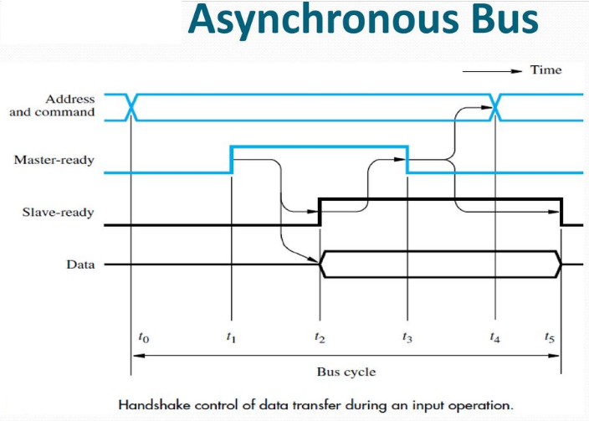

Slide 14
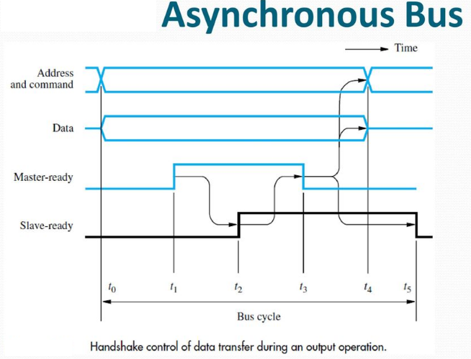

Slide 15
Arbitration
There are occasions when two or more entities contend for the use of a single resource in a computer system.
For example, two devices may need to access a given slave at the same time. In such cases, it is necessary to decide which device will access the slave first.
The decision is usually made in an arbitration process performed by an arbiter circuit.
The arbitration process starts by each device sending a request to use the shared resource.
The arbiter associates priorities with individual requests. If it receives two requests at the same time, it grants the use of the slave to the device having the higher priority first.

Slide 16
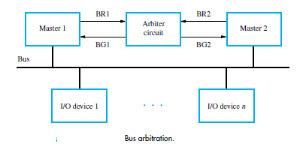

Slide 17
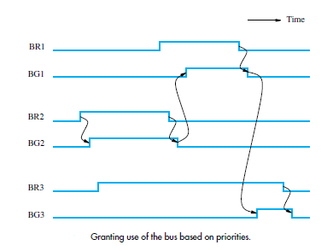

Slide 18
Interface circuits

Slide 19
Interface circuits
I/O interface consists of the circuitry required to connect an I/O device to a computer bus.
One side of the interface which connects to the computer has bus signals for:
Address,
Data
Control
Otherside of the interface which connects to the I/O device has:
Datapath and associated controls to transfer data between the interface and the I/O device.
This side is called as a “port”.
Ports can be classified into two:
Parallel port,
Serial port.

Slide 20
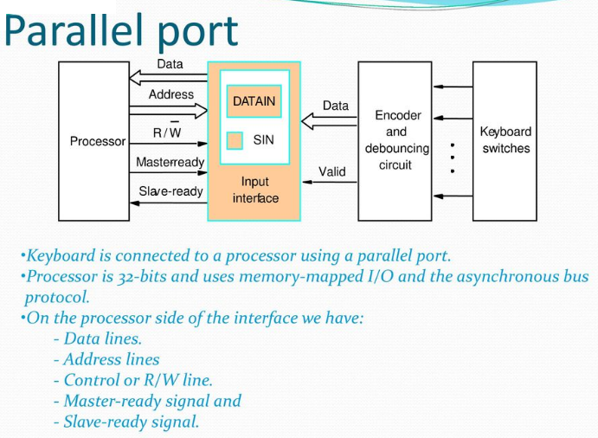

Slide 21
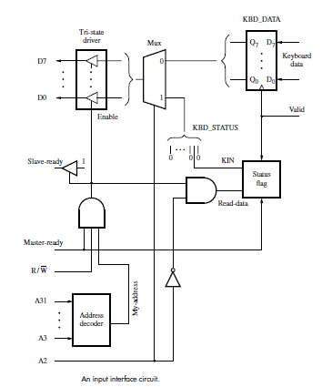
Input interface circuit

Slide 22
Input Interface Circuit
Output lines of DATAIN are connected to the data lines of the bus by means of 3 state drivers
Drivers are turned on when the processor issues a read signal and the address selects this register.
SIN signal is generated using a status flag circuit. It is connected to line D0 of the processor bus using a three-state driver. Address decoder selects the input interface based on bits A3 through A31.
Bit A0 determines whether the status or data register is to be read, when Master-ready is active.
In response, the processor activates the Slave-ready signal, when either the Read-status or Read-data is equal to 1, which depends on line A0.

Slide 23
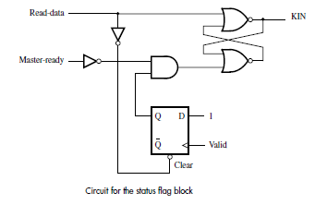

Slide 24
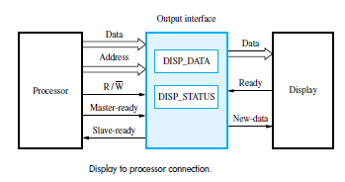
Output interface circuit

Slide 25
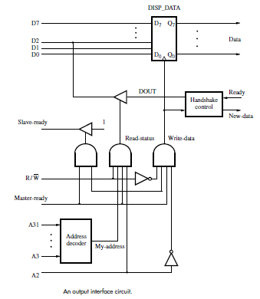
Output interface circuit

Slide 26
Serial port
Serial port is used to connect the processor to I/O devices that require transmission of data one bit at a time.
Serial port communicates in a bit-serial fashion on the device side and bit parallel fashion on the bus side.
Transformation between the parallel and serial formats is achieved with shift registers that have parallel access capability.

Slide 27
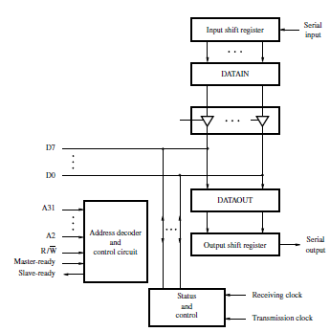
Serial interface circuit

Slide 28
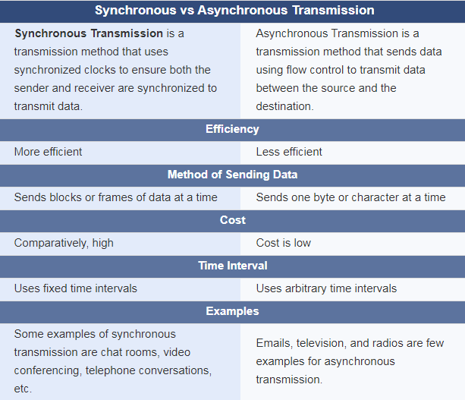

Slide 29
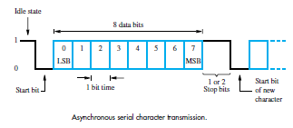

Slide 30
I/O device is connected to a computer using an interface
A personal computer has:
A motherboard which houses the processor chip, main memory and some I/O interfaces.
A few connectors into which additional interfaces can be plugged.
Processor bus is defined by the signals on the processor chip.
Devices which require high-speed connection to the processor are connected directly to this bus.
Motherboard usually provides another bus that can support more devices.
Processor bus and the other bus (called as expansion bus) are interconnected by a circuit called “bridge”.
Devices connected to the expansion bus experience a small delay in data transfers.
Interconnection Standards

Slide 31
Standard I/O interfaces
A number of standards have been developed for the expansion bus.
Some have evolved by default.
For example, IBM’s Industry Standard Architecture.
Three widely used bus standards:
PCI (Peripheral Component Interconnect)
SCSI (Small Computer System Interface)
USB (Universal Serial Bus)

Slide 32
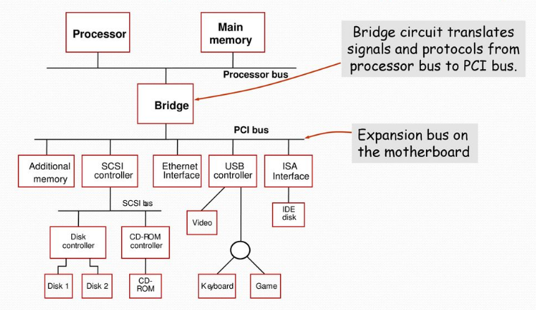
Standard I/O interfaces

Slide 33
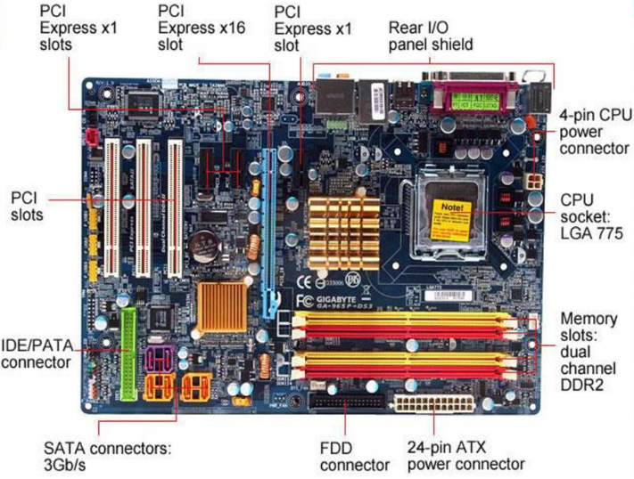

Slide 34
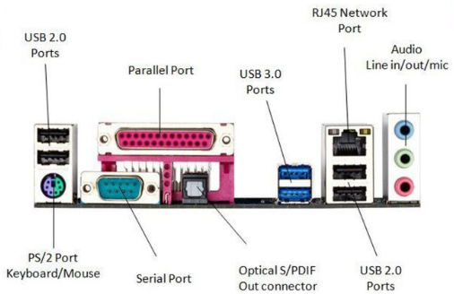
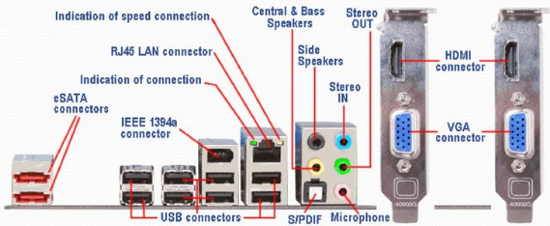

Slide 35
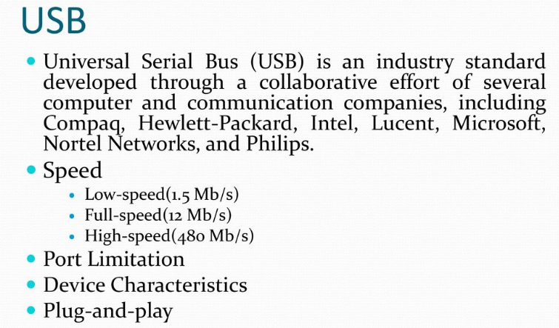

Slide 36
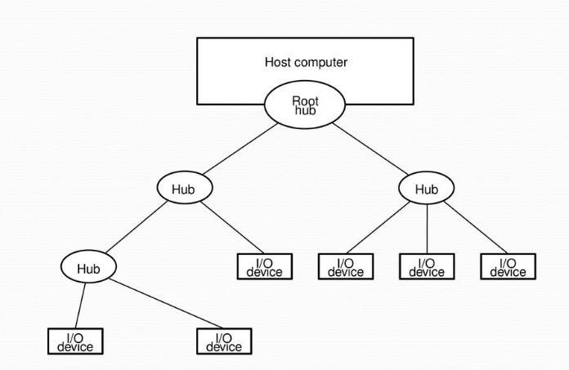
Universal Serial Bus tree structure

Slide 37
Universal Serial Bus tree structure
To accommodate a large number of devices that can be added or removed at any time, the USB has the tree structure. Each node of the tree has a device called a hub, which acts as an intermediate control point between the host and the I/O devices.
At the root of the tree, a root hub connects the entire tree to the host computer. The leaves of the tree are the I/O devices being served (for example, keyboard, Internet connection, speaker, or digital TV)In normal operation, a hub copies a message that it receives from its upstream connection to all its downstream ports.
As a result, a message sent by the host computer is broadcast to all I/O devices, but only the addressed device will respond to that message.
However, a message from an I/O device is sent only upstream towards the root of the tree and is not seen by other devices.

Slide 38
USB Protocols
All information transferred over the USB is organized in packets, where a packet consists of one or more bytes of information. There are many types of packets that perform a variety of control functions.
The information transferred on the USB can be divided into two broad categories: control and data. Control packets perform such tasks as addressing a device to initiate data transfer, acknowledging that data have been received correctly, or indicating an error.
Data packets carry information that is delivered to a device. A packet consists of one or more fields containing different kinds of information. The first field of any packet is called the packet identifier, PID, which identifies the type of that packet.
They are transmitted twice. The first time they are sent with their true values, and the second time with each bit complemented The four PID bits identify one of 16 different packet types.

Slide 39
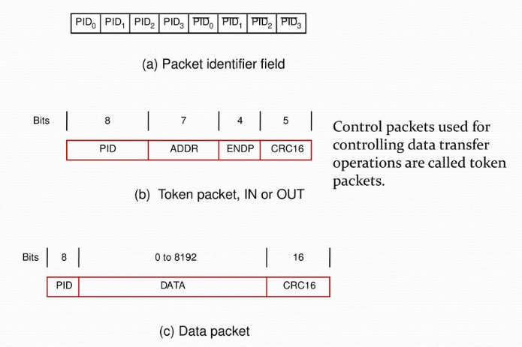
USB packet format

Slide 40
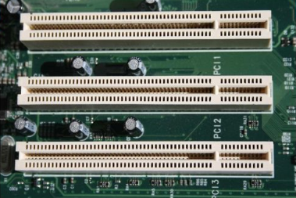
PCI Bus (Peripheral Component Interconnect)
Low-cost bus
Processor independent
Plug-and-play capability
In today’s computers, most memory transfers involve a burst of data rather than just one word. The PCI is designed primarily to support this mode of operation.
The bus supports three independent address spaces: memory, I/O, and configuration.
We assumed that the master maintains the address information on the bus until data transfer is completed. But, the address is needed only long enough for the slave to be selected.
Thus, the address is needed on the bus for one clock cycle only, freeing the address lines to be used for sending data in subsequent clock cycles. The result is a significant cost reduction.
A master is called an initiator in PCI terminology. The addressed device that responds to read and write commands is called a target.

Slide 41
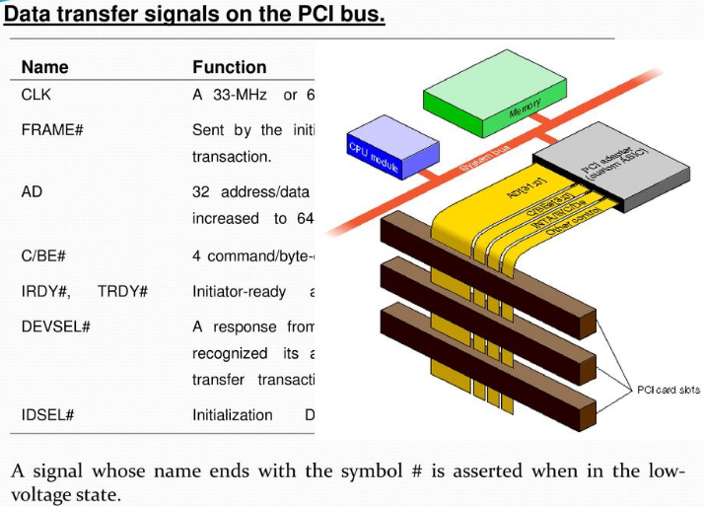

Slide 42
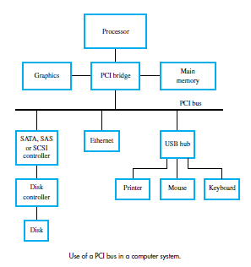

Slide 43
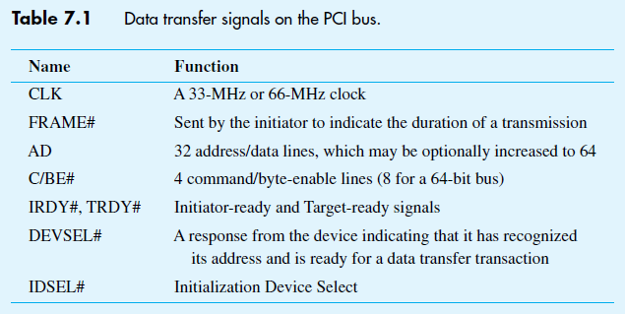

Slide 44
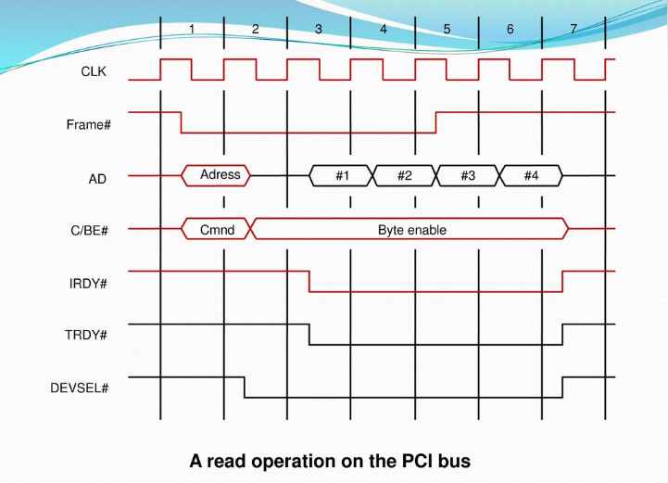

Slide 45
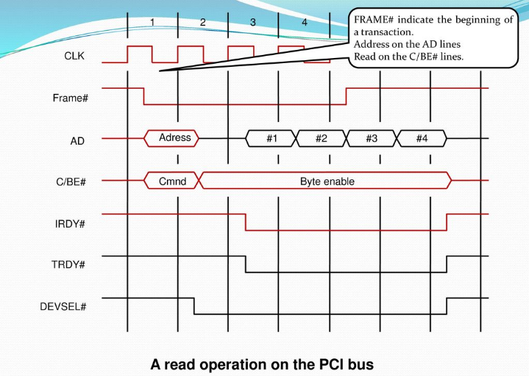

Slide 46
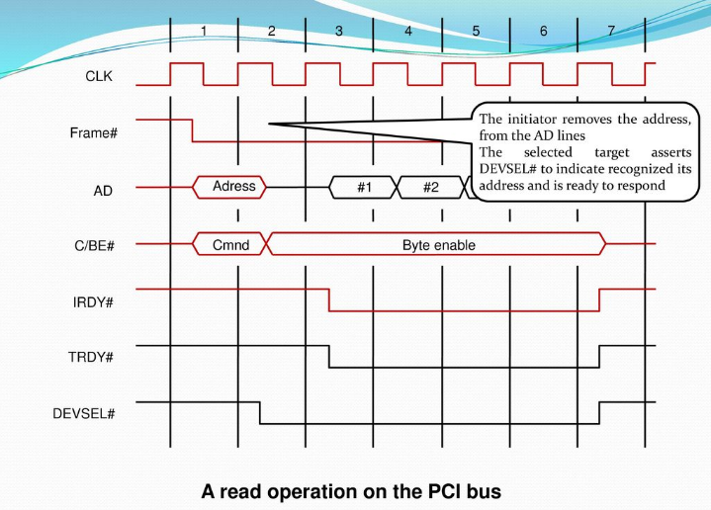

Slide 47
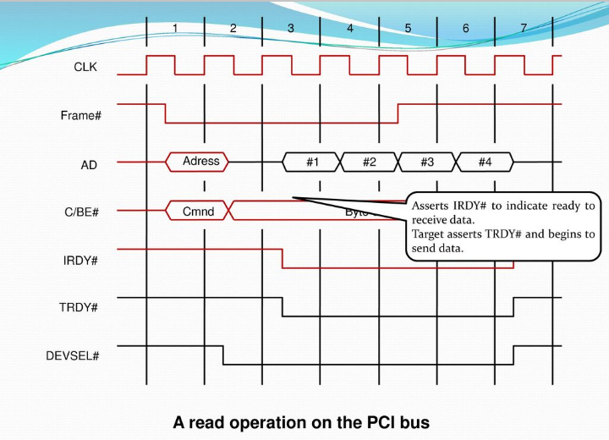

Slide 48
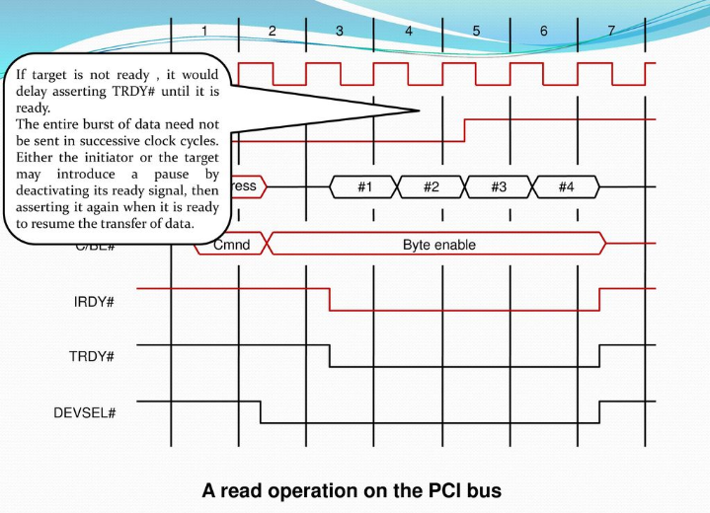

Slide 49
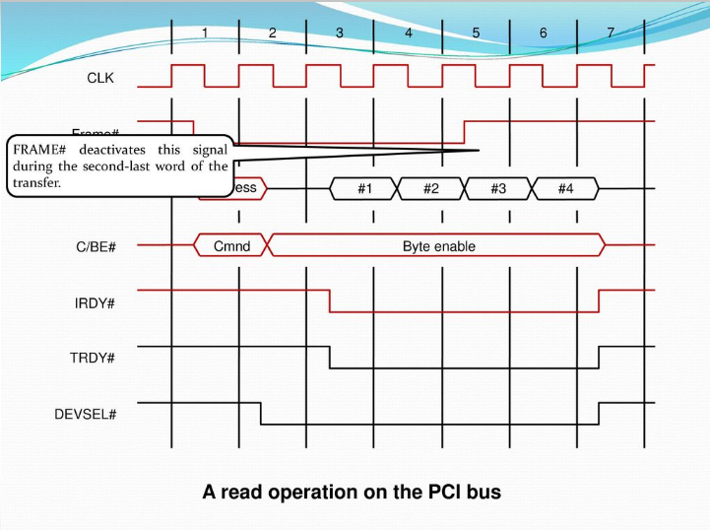

Slide 50
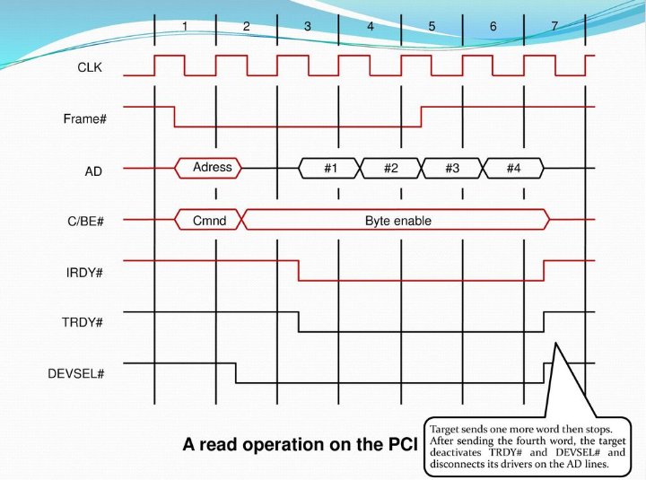

Slide 51
SCSI Bus (Small Computer System Interface)
It refers to a standard bus defined by the American National Standards Institute (ANSI) under the designation X3.131
In the original specifications of the standard, devices such as disks are connected to a computer via a 50-wire cable, which can be up to 25 meters in length and can transfer data at rates up to 5 megabytes/s.
The SCSI bus standard has undergone many revisions, and its data transfer capability has increased very rapidly, almost doubling every two years.
SCSI-2 and SCSI-3 have been defined, and each has several options.
Because of various options SCSI connector may have 50, 68 or 80 pins.

Slide 52
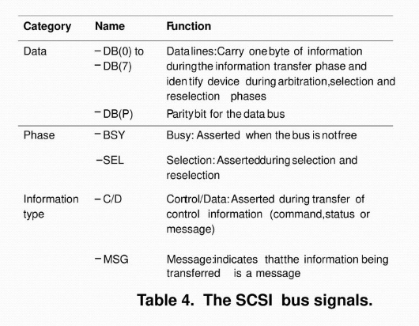

Slide 53
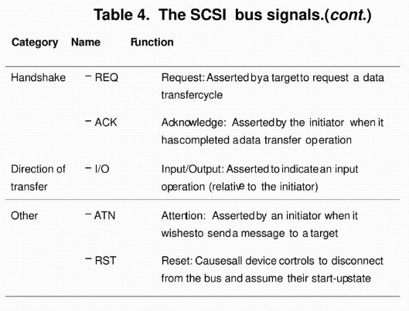

Slide 54
The processor sends a command to the SCSI controller, which causes the following sequence of events to take place:
The SCSI controller contends for control of the SCSI bus.
2. When it wins the arbitration process, the SCSI controller sends a command to the disk controller, specifying the required Read operation.
3. The disk controller cannot start to transfer data immediately. It must first move the read head of the disk to the required sector. Hence, it sends a message to the SCSI controller indicating that it will temporarily suspend the connection between them. The SCSI bus is now free to be used by other devices.

Slide 55
4.The disk controller sends a command to the disk drive to move the read head to the first sector involved in the requested Read operation. It reads the data stored in that sector and stores them in a data buffer. When it is ready to begin transferring data, it requests control of the bus. After it wins arbitration, it re-establishes the connection with the SCSI controller, sends the contents of the data buffer, then suspends the
connection again.
5. The process is repeated to read and transfer the contents of the second disk sector.
6. The SCSI controller transfers the requested data to the main memory and sends an interrupt to the processor indicating that the data are now available.

Slide 56
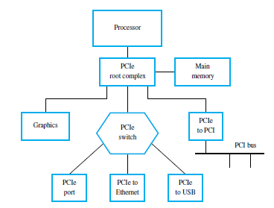
PCI Express

